Slide 1

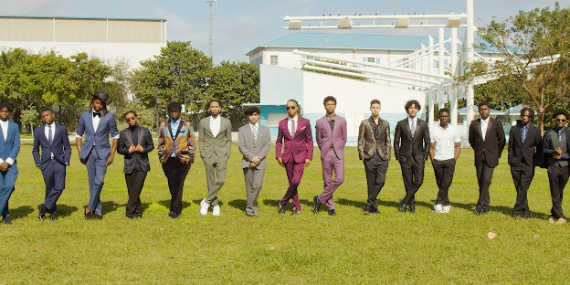
Partnership Proposal Presentation
MAY 2024

Slide 2


About Young Men of Distinction
Young Men of Distinction is committed to empowering today's youth to reach their full potential.
MISSION
Our mission is to increase opportunities for adolescent boys to prosper through mentorship, motivation and guidance, helping them transition into young men with purpose and obtain a higher education.
VISION
​Our vision is to create a mentoring culture where all male members of the community can be empowered, enabling young men to become better fathers, community leaders, husbands, students, employees, entrepreneurs, business owners, friends, and more.

Slide 3
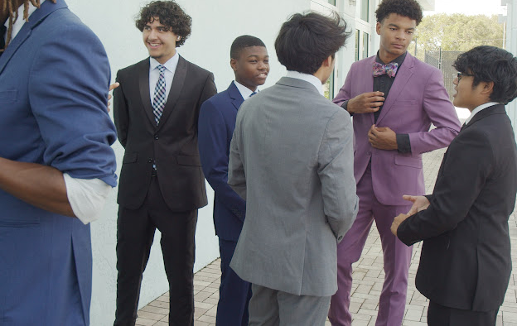
2nd Annual YMOD Flash Mob
Palm Beach County Edition
Sunday, November 3, 2024
PURPOSE:
To showcase the young men of Palm Beach County and highlight local suit businesses within the community.
This event symbolizes passing the torch to our young kings, representing growth and leadership within YMOD.

Slide 4



Importance of Sponsorship
Generational Empowerment
Tangible Skills
We are dedicated to empowering future generations by providing guidance and positive role models for young men.
Our programs equip youth with practical skills to build bright futures, fostering confidence in entrepreneurship and financial independence.
Supporting Families
Fulfilling Potential
Sponsorship enables us to support the needs of families, helping them secure a better future and retire with dignity.
With your support, we can help young men reach their full potential, contributing positively to their communities and beyond.

Slide 5
Sponsorship Tiers Overview
Gold
Silver
Premium support with exclusive opportunities for brand exposure.
Platinum
Mid-level support offering comprehensive support for initiatives and programs.
Elevated support with exclusive benefits and prominent brand recognition.
Bronze
Basic support for essential programs and initiatives.
1
2
3
4

Slide 6
Sponsorship Tier 1 - Bronze
Donation Amount: $750
Amenities:
  International Press Release: Your company will be featured in our international press release, showcasing your commitment to community empowerment on a global scale.
  Digital Program: Gain visibility with your company name and logo featured on our digital program, reaching a wide audience of supporters and stakeholders.
  Conference Promotion: Ensure your brand is seen by attendees with a promotional item included in our conference gift bags.
  Website Recognition: Enjoy recognition on our conference website, with your company name and logo displayed prominently and linked to your promotional landing page.
  Promotional Link: Drive traffic to your business with a dedicated link on our conference website, directing attendees to your promotional landing page for more information.
Bronze
Basic support for essential programs and initiatives.
1

Slide 7
Sponsorship Tier 2 - Platinum
Donation Amount: $2,000
Amenities:
  International Press Release: Your company will be prominently featured in our international press release, highlighting your significant contribution to our mission.
  Digital Program: Gain maximum visibility with your company name and logo prominently displayed on our digital program, reaching a wide audience of supporters and stakeholders.
  Conference Promotion: Ensure your brand stands out with a promotional item included in our conference gift bags.
  Website Recognition: Enjoy premium recognition on our conference website, with your company name and logo prominently displayed and linked to your promotional landing page.
  Promotional Link: Drive traffic to your business with a dedicated link on our conference website, directing attendees to your promotional landing page for more information.
Platinum
Elevated support with exclusive benefits and prominent brand recognition.
2

Slide 8
Sponsorship Tier 3 – Silver
Donation Amount: $3,500
Amenities:
  International Press Release: Gain exposure with your company prominently featured in our international press release.
  Digital Program: Ensure visibility with your company name and logo featured on our digital program, reaching a wide audience.
  Conference Promotion: Stand out with a promotional item included in our conference bags.
  Website Recognition: Enjoy recognition on our conference website, with your company name and logo prominently displayed and linked to your promotional landing page.
  Lobby Video Screen: Showcase your brand on our lobby video screen, ensuring visibility to all attendees throughout the event.
  Social Media Presence: Increase your online presence with your company logo featured on social media and online materials.
  Stage Banner: Gain visibility with your company logo prominently displayed on our stage banner during our events.
  Sponsored Social Media Posts: Benefit from 20 sponsored Facebook and Instagram posts, with "Sponsored by" mentions featuring your logo.
Silver
Mid-level support offering comprehensive support for initiatives and programs.
3

Slide 9
Sponsorship Tier 4 – Gold
Donation Amount: $6,000
Amenities:
  International Press Release: Gain global exposure with your company prominently featured in our international press release.
  Digital Program: Ensure maximum visibility with your company name and logo prominently displayed on our digital program.
  Conference Promotion: Stand out with a promotional item included in our conference bags.
  Website Recognition: Enjoy premium recognition on our conference website, with your company name and logo prominently displayed and linked to your promotional landing page.
  Lobby Video Screen: Showcase your brand on our lobby video screen throughout the event.
  Social Media Presence: Increase your online presence with your company logo featured on social media and online materials.
  Stage Banner: Gain prominent visibility with your company logo prominently displayed on our stage banner during our events.
  Flag Logo: Showcase your brand with a flag logo in the lobby, ensuring maximum exposure to all event attendees.
Gold
Premium support with exclusive opportunities for brand exposure.
4

Slide 10
Sponsorship Tier 4 – Gold
Amenities:
  Keynote Slot: Gain exclusive exposure with a 20-minute keynote slot, showcasing your brand and expertise to our audience.
  Promotional Presentation: Present your company with a promotional presentation with our audience.
  Conference Video Screens: Ensure visibility with your logo featured on conference video screens throughout the event.
  Sponsored Social Media Posts: Benefit from 40 sponsored Facebook and Instagram posts, with "Sponsored by" mentions featuring your logo.
  Logo on Sponsored Ads: Ensure visibility with your logo featured on all sponsored ads on Instagram and Facebook.
  Logo on Promotional Materials: Ensure brand visibility with your logo featured on all promotional materials for the event, including advertising, event communication, social media, and press coverage.
  Logo on Email Blasts: Gain visibility with your logo featured on all email blasts and corporate email correspondence related to the event.
  On-Site Interview: Engage directly with our audience with an on-site interview on Facebook Live in the media podcast suite, ensuring personalized engagement and brand exposure.
Gold
Premium support with exclusive opportunities for brand exposure.
4

Slide 11





In-Kind Contributions
Meaningful Support
Food & Beverage
Gift Items & Signage
Raffle Prizes
Meeting Materials
In addition to monetary sponsorships, we welcome in-kind contributions that provide tangible support for our events and initiatives.
Help us create memorable experiences by providing food and beverages for our events, ensuring our attendees are well-fed and energized.
Contribute gift items and signage to enhance the experience for our attendees, leaving a lasting impression and reinforcing your brand presence.
Donate raffle prizes to add excitement and engagement to our events, rewarding attendees and increasing participation.
Support our programs with meeting materials such as notebooks, pens, and other essentials, ensuring our events run smoothly and efficiently.

Slide 12
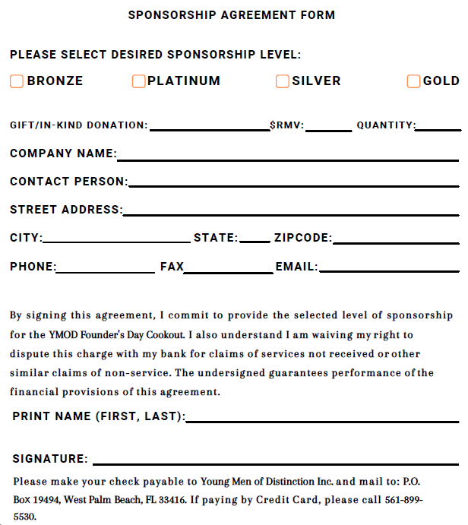
Sponsorship Agreement Form

Slide 13




Contact Information
P.O. Box 19494, West Palm Beach, FL 33416
5 6 1 - 9 0 9 - 5 0 4 9
jacoby.waters@youngmenofdistinction.org
Notes:
https://images.unsplash.com/photo-1586769852044-692d6e3703f0

Slide 14
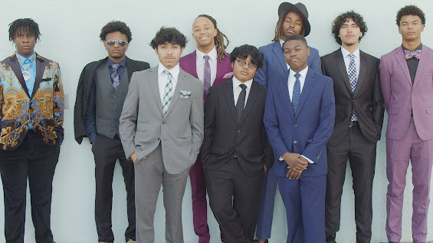
THANK YOU.

